Slide 1
Data Structures & Algorithms
Notes:
<number>

Slide 2
Lecture 05
Generic Programming
Stacks & Queues
1
Notes:
<number>

Slide 3
Generic Types
A generic type is a generic class or interface that is parameterized over types
A generic class is defined with the following format: class ClassName<T1, T2, ..., Tn> { /* ... */ }
The type parameter section, delimited by angle brackets (<>), follows the class name
It specifies the type parameters (also called type variables) T1, T2, ..., & Tn
Notes:
<number>

Slide 4
Generic Types
In other word a generic class is a class that can be used with any Object type
Object type: any object can be passed or returned BUT not primitive types
The type is defined between the angular brackets
The Class is initially defined with the generic type e.g. <E>
Notes:
<number>

Slide 5
Generic Types
The most commonly used type parameter names are:
E - Element (used extensively by the Java Collections Framework)
K - Key
N - Number
T - Type
V - Value
S,U,V etc. - 2nd, 3rd, 4th types

Slide 6
Generic Programming
Type parameterization.
A generic class className<T> is a type pattern covering infinite set of possible types.
Only becomes actual type when it is generically derived.
Type patterns once derived may only contain elements of the actual generic type.
Allows type checking at compile-time. Reduces run-time error.
Used in Collection interfaces.
This approach is used in various languages:
Ada, Eiffel, Java, C#, F#, VB.Net, Scala.
<number>

Slide 7
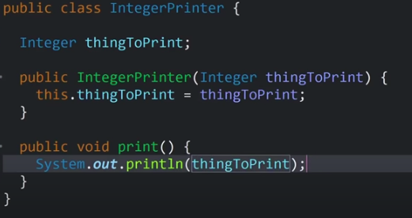

Slide 8
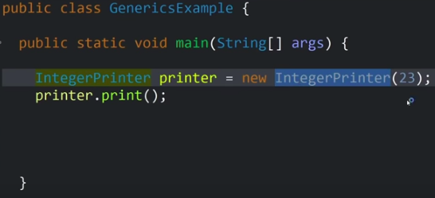

Slide 9
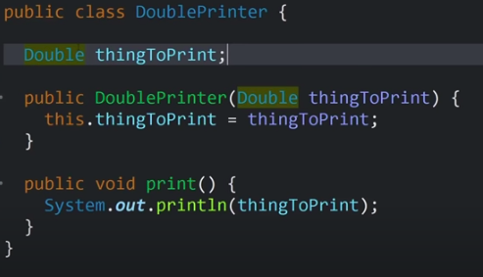

Slide 10
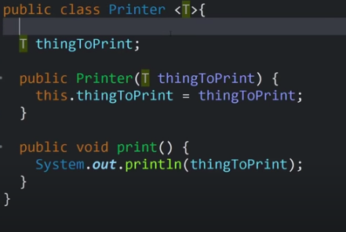

Slide 11
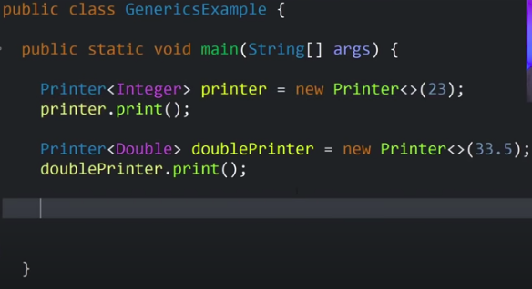

Slide 12
Generic Programming – Example
Describing a generic array class.
public class GenericArray<T>{
private T[] data;
int size = 0;
public GenericArray(){
data = (T[])(new Object[50]);
}
public GenericArray(int n){
data = (T[])(new Object[n]);
}
public void add(T element){
data[size] = element;
size++;
}
public int length(){
return size;
}
}
<number>
Notes:
We begin our study of generic data structures by implementing a generic array class. The name of the class includes the parameter T as an argument in its header and the private attribute data is declared as array of type T. However, in Java we cannot dynamically create an array with a deferred type T. To get around this restriction we create an Object array of size 50 and type cast it to array T. The default constructor is: data = (T[])(new Object[50]). This line of code causes the compiler to throw an unchecked type conversion warning. We simply suppress this and choose to ignore it because the type conversion is good. There is also a second constructor that takes creates an initial array of length n. The attribute size simply records the number of elements currently in the data array. Its initial value is 0. Method add takes a value x of type T and assigns it to the data array. Note that this method throws an exception if the array is full. However, we choose to ignore this problem for now because we want to focus exclusively on how to work with genericity.
<number>

Slide 13
Generic Programming – Example
Testing the GenericArray class.
public class GenericArrayTest {
public static void main(String[] args) {
GenericArray<Integer> intArry = new GenericArray<Integer>();
for(int j = 0; j < 20; j++){
intArry.add(new Integer(j));
}
System.out.println(intArry.length());
// Creating a String type array
GenericArray<String> stArry = new GenericArray<String>(10);
stArry.add("Monday");
stArry.add("Tuesday");
System.out.println(stArry.length());
}
}
<number>
Notes:
To use this class in a program we must substitute an actual type for the parameter T when
declaring an instance of the GenericArray<T> class. The following program illustrates its use by
creating two different instances of GenericArray<T>. The derived type must always be an object class because genericity is not defined for primitive types.
<number>

Slide 14
Generic Programming – Searching or sorting
Generic class is simple to write and easy to use.
It eliminates the need for duplicating code.
However, problem arises when searching or sorting elements.
Classes must implement comparison methods:
compareTo
equals
Java’s Comparable interface includes compareTo method
interface Comparable<T>{
public int compareTo(T o);
}
<number>

Slide 15
Generic Programming – Example
A generic array class which implements Comparable.
public class GenericArray<T extends Comparable<T>>{
private T[] data;
int size = 0;
public GenericArray(){
data = (T[])(new Comparable[50]);
}
public GenericArray(int n){
data = (T[])(new Comparable[n]);
}
public void add(T element){
data[size] = element;
size++;
}
public int length(){
return size;
}
<number>
Notes:
Why <T extends Comparable<T>>
why not <T implements Comparable<T>>
<number>

Slide 16
Generic Programming – Example
A generic array class which implements Comparable.
public boolean search(T element){
int j = 0;
boolean found = false;
while(j < size && !found){
if(data[j].compareTo(element) == 0)
found = true;
else
j++;
}
return found;
}
} // class end
<number>

Slide 17
Generic Programming – Example
Testing the GenericArray class.
public class GenericArrayTest {
public static void main(String[] args) {
GenericArray<String> st = new GenericArray<String>();
st.add("Hello");
st.add("now");
boolean b = st.search("now");
System.out.println(b);
}
}
<number>

Slide 18
Generic Programming – Iteration
An iterator is an object that allows traversal over a given data structure.
It is private to the class.
It knows how the data in the class is ordered.
Java’s Iterator interface has 3 methods:
next() – returns next element in data structure.
hasNext() – returns true if there are more elements in data structure.
remove() – removes most recently visited element. And it is optional.
Must import java.util.* in order to use Iterator.
<number>
Notes:
Often, you will want to cycle through the elements in a collection. For example, you might want to display each element. The easiest way to do this is to emploan iterator, which is an object that implements either the Iterator or the ListIterator interface.
<number>

Slide 19
Generic Programming – Example
Writing an ArrayIterator class, which is private in the GenericArray class.
private static class ArrayIterator<T> implements Iterator<T>{
private T[] data;
private int index = 0;
private int size;
ArrayIterator(T[] d, int s){
data = d;
size = s;
}
<number>

Slide 20
Generic Programming – Example
Writing an ArrayIterator class, which is private in the GenericArray class.
public boolean hasNext(){
return index < size;
}
public T next(){
if(index == size){
throw new NoSuchElementException();}
T item = (T)data[index];
index++;
return item;
}
public void remove(){}
} // class end
<number>

Slide 21
Generic Programming – Example
Now adding the following method to GenericArray class:
public Iterator<T> iterator(){
return new ArrayIterator<T>(data, size);
}
<number>

Slide 22
Generic Programming – Example
Testing the GenericArray class for iteration.
public class ArrayIteratorTest {
public static void main(String[] args) {
GenericArray<String> st = new GenericArray<String>();
st.add("Adam");
st.add("John");
st.add("Declan");
st.add("Owen");
st.add("Bary");
// iteration through objects
Iterator<String> it = st.iterator();
while(it.hasNext()){
System.out.println(it.next()+ " ");
}
}
}
<number>

Slide 23
Generic Stack
A stack is a last in, first out linear data structure.
This means that elements are removed in inverse order to their insertion.
Those last in get to leave first.
<number>

Slide 24
Generic Stack
Stack interface:
Can be implemented using:
Array
Linked List
interface Stack<E>{
public boolean push(E x);
public boolean pop();
public E top();
public boolean empty();
public boolean full();
}
<number>

Slide 25
Generic Stack – LinkedList Implementation
Generic Node class:
class Node<E>{
E data;
Node<E> next;
public Node(E x){
data = x;
next = null;
}
public Node<E> getNext(){
return next;}
public void setNext(Node<E> p){
next = p;}
public void setData(E x){
data = x;}
public E getData(){
return data;}
}
<number>

Slide 26
Generic Stack – LinkedList Implementation
Implementation of StackList class.
class StackList<E> implements Stack<E>{
Node<E> head;
int size = 0;
public StackList(){
head = null;
}
<number>

Slide 27
Generic Stack – LinkedList Implementation
Implementation of StackList class.
public boolean push(E x){ //add at head
Node<E> nw = new Node<E>(x);
nw.setNext(head);
head = nw;
size++;
return true;
}
<number>

Slide 28
Generic Stack – LinkedList Implementation
Implementation of StackList class.
public boolean pop(){
if(size > 0){ //remove at head
head = head.getNext();
size--;
return true;
}
else return false;
}
<number>

Slide 29
Generic Stack – LinkedList Implementation
Implementation of StackList class.
public E top(){
if(size > 0){
return head.getData();
}
else return null;
}
public boolean empty(){
return size == 0; // or head == null
}
<number>

Slide 30
Generic Stack – LinkedList Implementation
Implementation of StackList class.
public boolean full(){
return false;
}
public Iterator<E> iterator(){
return new StIterator<E>(head, size);
}
} //class end
<number>

Slide 31
Generic Stack – LinkedList Implementation
Writing StIterator class inside the StackList class.
private static class StIterator<E> implements Iterator<E>{
private Node<E> d;
private int size;
private int index = 0;
StIterator(Node<E> dd, int s){
d = dd;
size = s;
}
<number>

Slide 32
Generic Stack – LinkedList Implementation
Writing StIterator class inside the StackList class.
public boolean hasNext(){
return index < size;
}
public E next(){
if(index == size){
throw new NoSuchElementException();}
E item = (E) d.getData();
d = d.getNext();
index++;
return item;
}
public void remove(){}
} // class end
<number>

Slide 33
Generic Stack – LinkedList Implementation
Testing the Stack implementation:
public class StackTest {
public static void main(String[] args) {
StackList<Integer> st1 = new StackList<Integer>();
for(int j = 0; j < 10; j++){
st1.push(new Integer(j));
}
while(!st1.empty()){
System.out.print(st1.top()+" ");
st1.pop();
}
<number>

Slide 34
Generic Stack – LinkedList Implementation
Testing the Stack implementation:
for(int j = 0; j < 10; j++) {
st1.push(new Integer(j));
}
System.out.println();
Iterator<Integer> it1 = st1.iterator();
while(it1.hasNext()){
System.out.print(it1.next()+" ");
}
} //main end
} // class end
<number>

Slide 35
Simple Application of Stack
Write a program that reads a positive integer value and outputs it in binary form.
Solution:
while(number > 0){
int remainder = (number % 2);
//store remainder
number = number/2;
}
<number>

Slide 36
Simple Application of Stack
Example:
public class OutputBinary{
public static void main(String[] args) {
StackList<Integer> st = new StackList<Integer>();
Scanner in = new Scanner(System.in);
int x = in.nextInt();
int number = x;
while(number > 0){
st.push(number % 2);
number = number / 2;
}
while(!st.empty()){
System.out.print(st.top());
st.pop();
}
}
}
<number>

Slide 37
Generic Queue
A queue is first in, first out linear data structure.
Elements are stored in chronological order and once en-queued may only be removed from the head of the queue.
<number>

Slide 38
Generic Queue
Queue interface:
Can be implemented using:
Array
Linked List
Typically, an array is used for a fixed size queue and a linked list for unbounded queues.
interface Queue<T>{
public boolean join(T x);
public T top();
public boolean leave();
public boolean full();
public boolean empty();
public void display();
}
<number>

Slide 39
Generic Queue – Implementation
Linear queue:
Join is O(1)
Leave is O(N)
Make leave O(1) by allowing both the head and tail of the list to rotate around the array.
<number>

Slide 40
Generic Queue – Implementation with Circular Array
Gives two possible queues:
Problem is how to update the values of head and tail when change occurs.
Use modulo arithmetic.
<number>

Slide 41
Generic Queue – Implementation with Circular Array
Join causes tail to be adjusted as follows:
tail = (tail+1)%queue.length
Leave modifies head such that
head = (head+1)%queue.length.
<number>

Slide 42
Generic Queue – Implementation with Circular Array
Join the queue:
public boolean join(T x){
if(size < queue.length){
queue[tail] = x;
tail = (tail+1)%queue.length;
size++;
return true;
}
else return false;
}
<number>

Slide 43
Generic Queue – Implementation with Circular Array
Leave the queue:
public boolean leave(){
if(size == 0)
return false;
else{
head = (head+1)%queue.length;
size--;
return true;
}
}
<number>

Slide 44
Generic Queue – Implementation with Circular Array
Implementation of CircularQueue class.
public class CircularQueue<T> implements Queue<T>{
private T queue[];
private int head, tail, size;
public CircularQueue(){
queue = (T[])new Object[20];
head = 0;
tail = 0;
size = 0;
}
public CircularQueue(int n){ //assume n >=0
queue = (T[])new Object[n];
size = 0;
head = 0;
tail = 0;
}
<number>

Slide 45
Generic Queue – Implementation with Circular Array
Implementation of CircularQueue class.
public T top(){
if(size > 0)
return queue[head];
else
return null;
}
public boolean full(){
return (size == queue.length);
}
public boolean empty(){
return (size == 0);
}
<number>

Slide 46
Generic Queue – Implementation with Circular Array
Implementation of CircularQueue class.
public Iterator<T> iterator(){
return new QIterator<T>(queue, head, size);
}
// ... join and leave methods
} // class end
<number>

Slide 47
Generic Queue – Implementation with Circular Array
Writing QIterator class inside the CircularQueue class.
private static class QIterator<T> implements Iterator<T>{
private T[] d;
private int index;
private int size;
private int returned = 0;
QIterator(T[] dd, int head, int s){
d = dd;
index = head;
size = s;
}
<number>

Slide 48
Generic Queue – Implementation with Circular Array
Writing QIterator class inside the CircularQueue class.
public boolean hasNext(){
return returned < size;
}
public T next(){
if(returned == size) {
throw new NoSuchElementException();}
T item = (T)d[index];
index = (index+1) % d.length;
returned++;
return item;
}
public void remove(){}
} // class end
<number>

Slide 49
Generic Queue – Implementation with Circular Array
Testing the CircularQueue class.
public class QueueTesting{
public static void main(String[] args) {
CircularQueue<Integer> cq = new CircularQueue<Integer>(6);
for(int i=0; i<6; i++){
cq.join(i);
}
cq.leave();
cq.join(7);
}
}
<number>

